Slide 1
Holiday Destinations Scores
Chloe Cooper

Slide 2
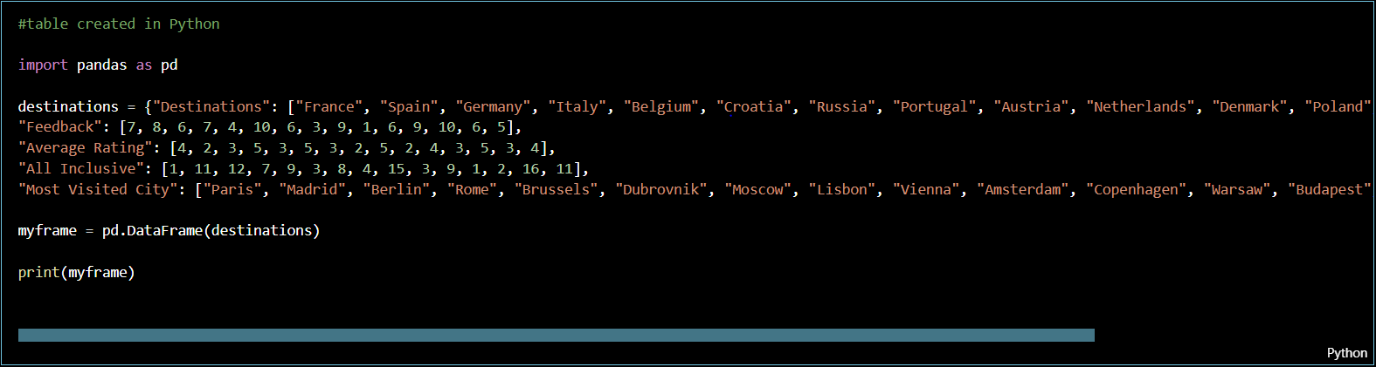
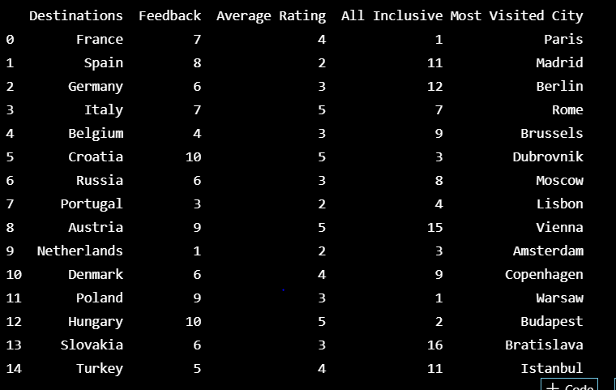
Holiday destinations table created in Python
Input:
A table has been created to show the scores given for each destination in the following sections; feedback (scored out of 10), average hotel rating (scored out of 5), number of all-inclusive hotels within each destination and the destinations most visited city. The table is completed and shown in the output.
Output:

Slide 3
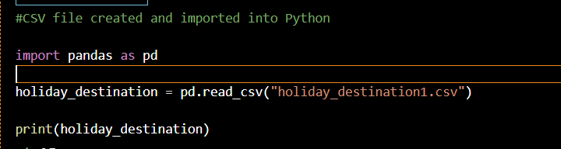
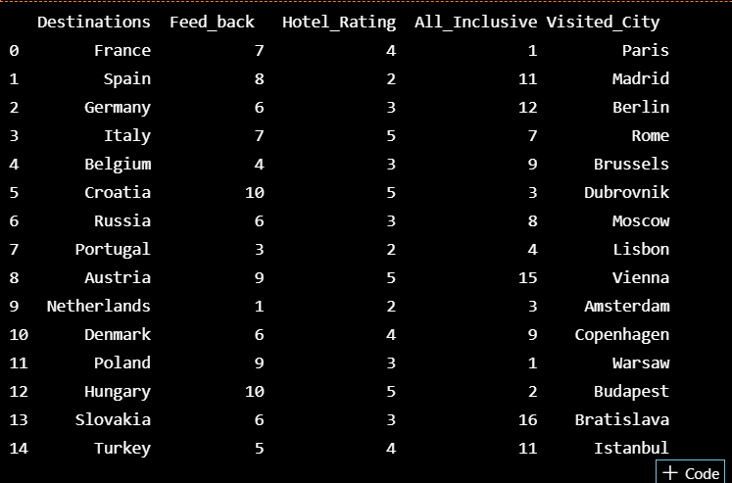
Holiday destinations CSV file created and imported into Python
Input:
Output:
The above shows a CSV file being imported in to Python to show the scores given for each destination in the sections mentioned in the previous slide. This has then been displayed in Python as a table.

Slide 4
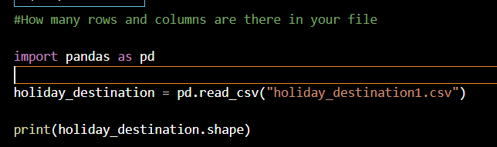

How many rows and columns are there in your file?
Input:
Output:
The above shows .shape being used to find out the number of rows and columns there are in the file. This means there is no need to manually count the rows/columns – it will be done automatically. The number of rows and columns is displayed in the output.

Slide 5
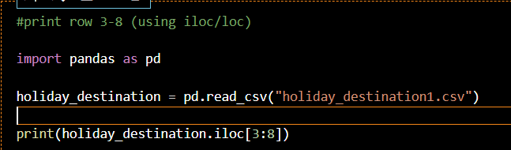
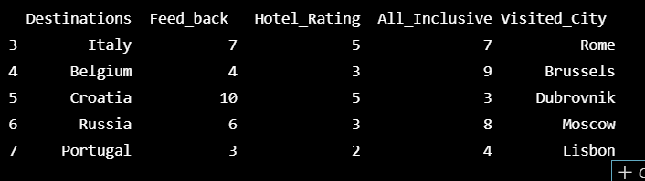
Print row 3-8 (using iloc/loc)
Input:
The input shows iloc being used to select rows 3-8. They have been printed and the results are displayed in the output table
Output:

Slide 6
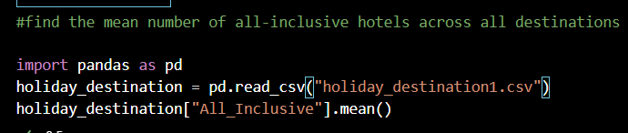

Find the mean number of all-inclusive hotels across all destinations
Input:
Output:
The above input shows the .mean method being used to find the mean number of all-inclusive hotels across all of the destinations.
The output is shows what has been produced by the input

Slide 7
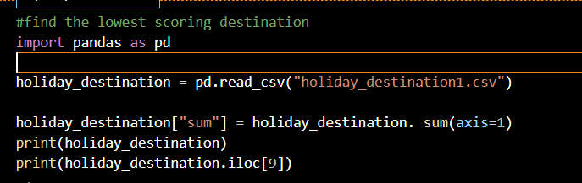
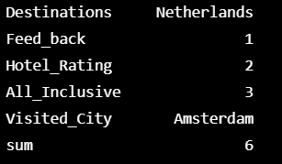
Find the lowest scoring destination
Input:
The above input shows each destinations scored being added up and entered into the sum column so that it can be determined who is the highest and lowest scoring.
The output shows us that The Netherlands were the lowest scoring destination with a total of 6.
Output:

Slide 8
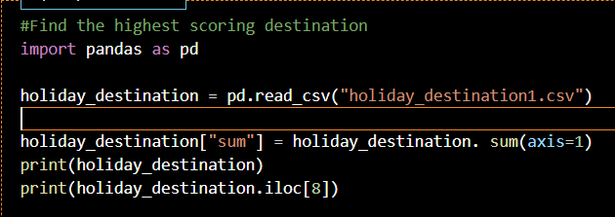
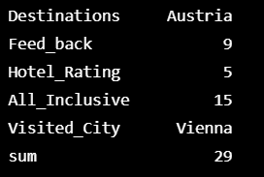
Find the highest scoring destination
Input:
The above input shows each destinations scored being added up and entered into the sum column so that it can be determined who is the highest and lowest scoring.
The output shows us that Austria was the highest scoring destination with a total of 29.
Output:

Slide 9
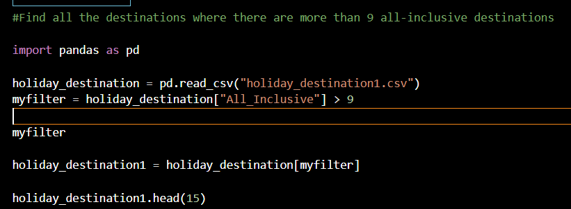
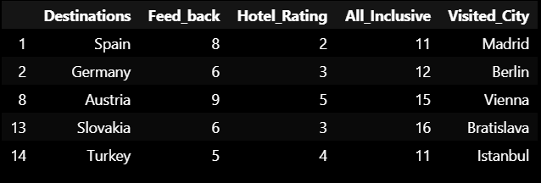
Find all the destinations where there are more than 9 all-inclusive hotels
Input:
Output:
A filter has been used to find the destinations where there are more than 9 all-inclusive hotels.
The output has produced the list of destinations with the filter of more than 9 for all-inclusive hotels.

Slide 10
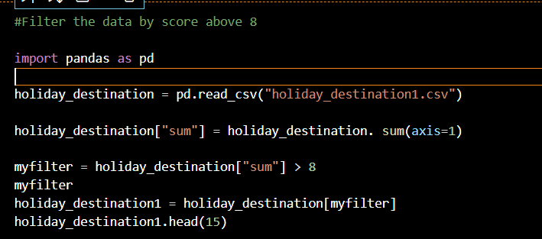
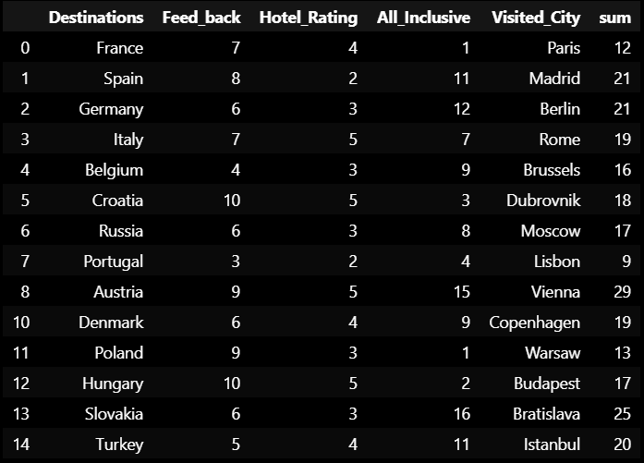
Filter the data by score above 8
Input:
Output:
The sum column has been used to filter the destinations with a score above 8.
The output has produced a table showing the results of the filter.

Slide 11
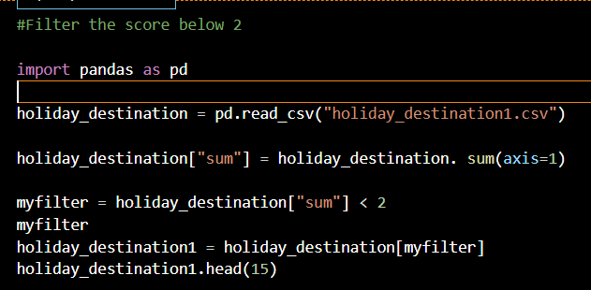

Filter the data score below 2
Input:
The sum column has been used to filter the destinations with a score below.
The output has produced a table showing the results of the filter. There are no destinations with a score below 2.
Output:

Slide 12
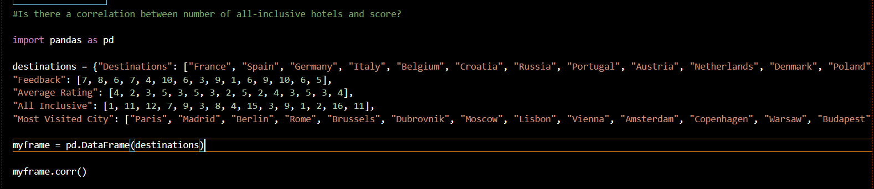
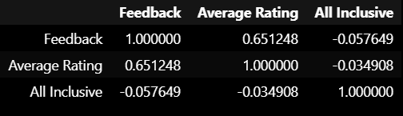
Is there a correlation between number of all-inclusive hotels and score?
Input:
Output:

Slide 13
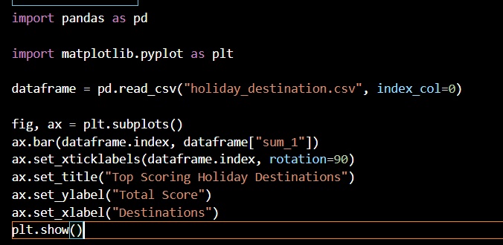
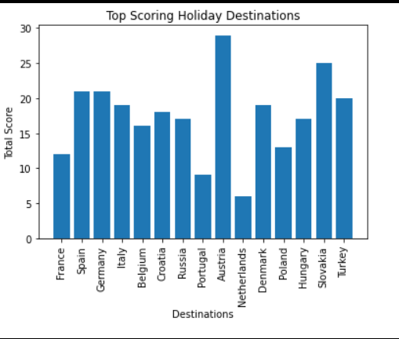
Create a data visualisation diagram to show destination and highest scores
The input shows how the bar chart has been created using the holiday destinations csv file. The scores have been added up to show the total score for each destination.
Output:
Input:
The output shows the bar chart which has been produced to show the top scoring holiday destinations.
As displayed Austria is the highest score with The Netherlands scoring the lowest.

